Slide 1
Framing cryptos in capital markets legislation – THE MiCAR PROPOSAL
Filippo Annunziata

Slide 2
CRIPTO-ASSETS:
CRYPTO CURRENCIES (more than 2.000 – see Advice Esma, 9.1.2019)
TOKENS (ICOs)

Slide 4
PAYMENT TOKENS: outside capital markets regulation
UTILITY TOKENS: outside capital markets regulation
ASSET TOKENS: if financial instruments, included in the scope of MiFID and prospectus
Other categories may exist under national law (ITALY – FINANCIAL PRODCT; USA «Howey test»)

Slide 5
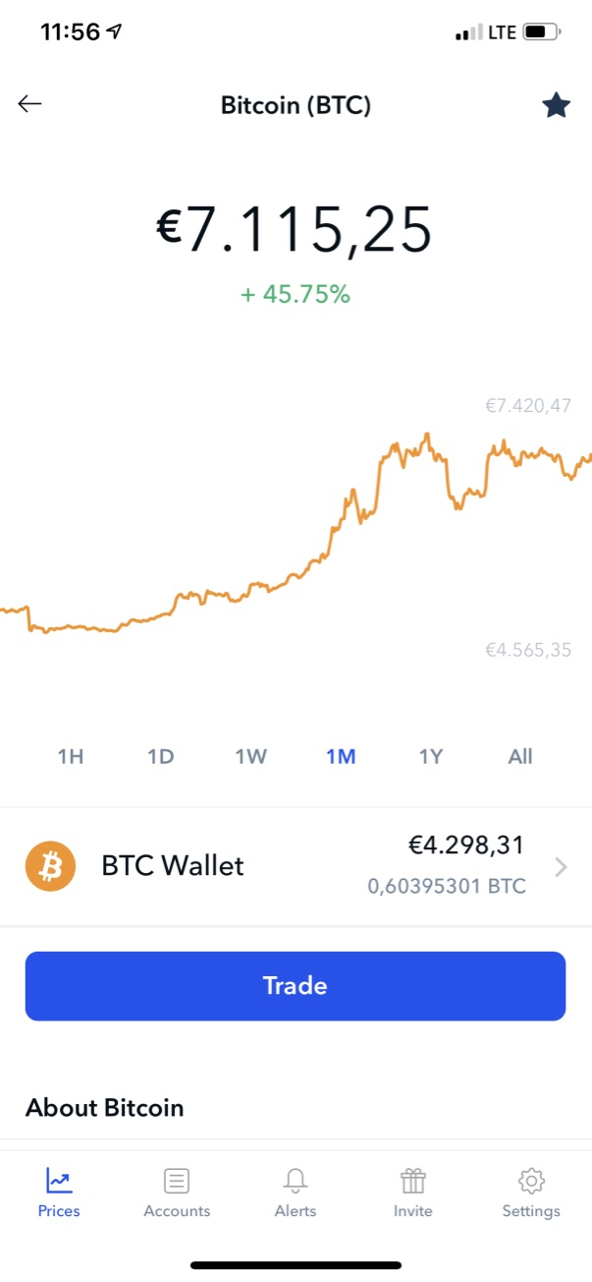
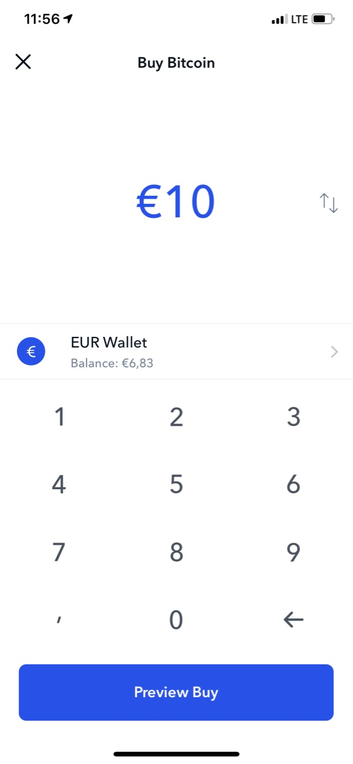
Platforms
BUY and SELL BTC

Slide 6
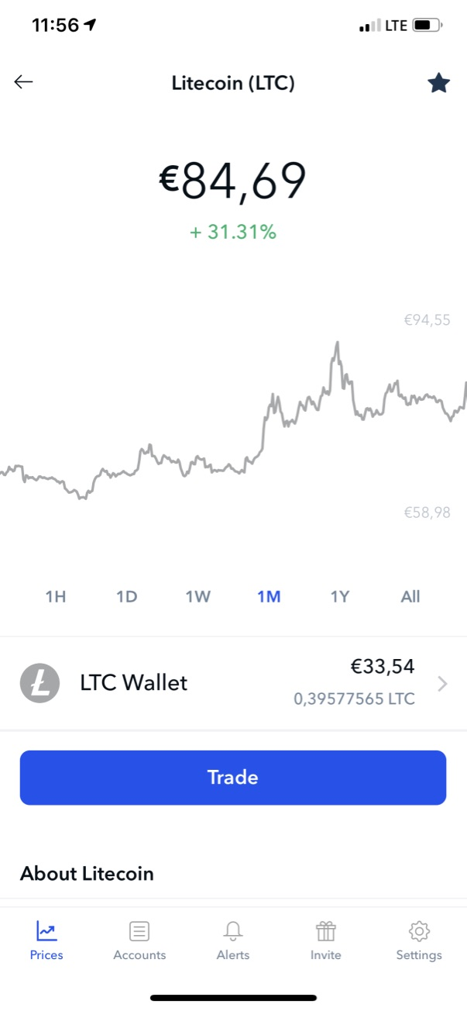
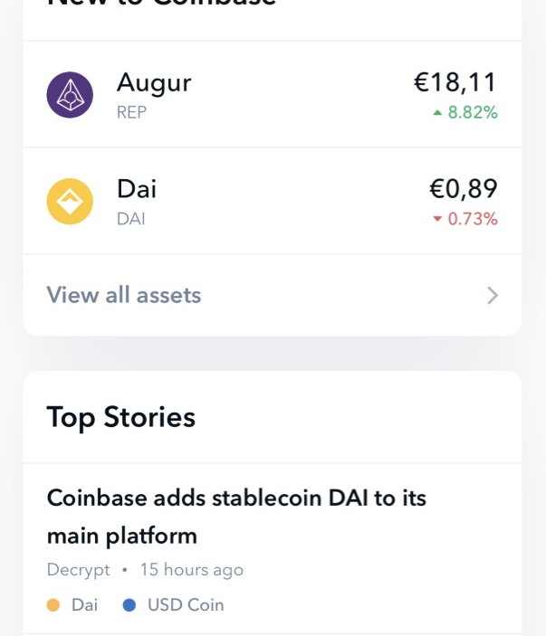
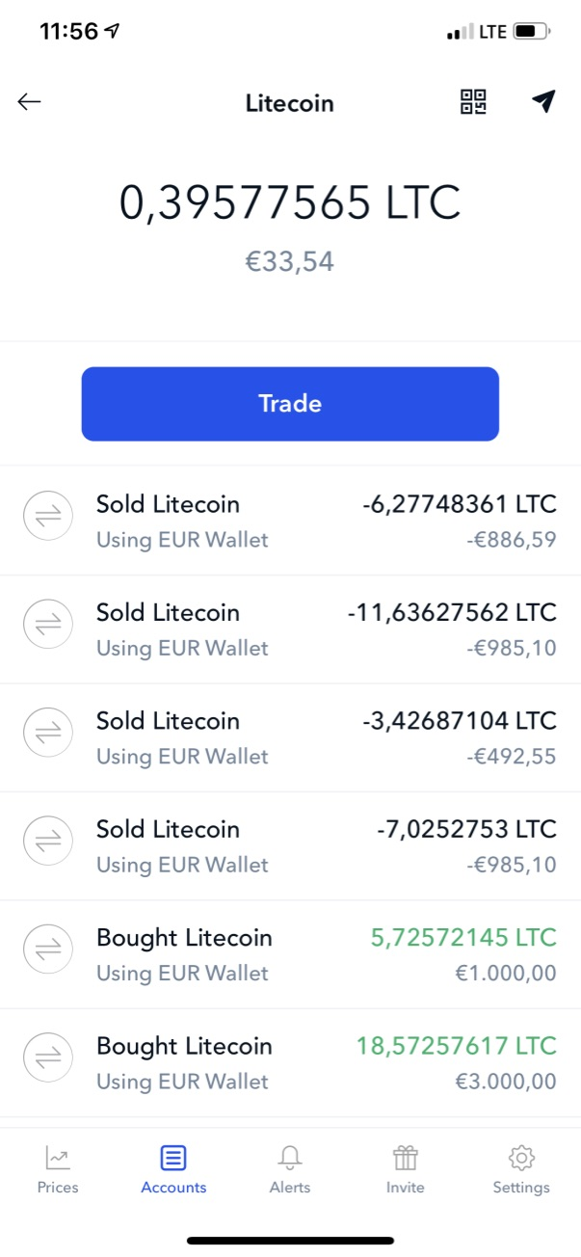
LITECOIN
information
trading
centralised

Slide 7
UTILITY TOKENS AS WELL might be Financial instruments falling within the scope of MiFID) if they are
Traded on a MiFID trading venue
AND
Qualify as derivatives

Slide 8
Proposal for a Regulation of the European Parliament and of the Council on Markets in Crypto-assets (MiCA)

Slide 9
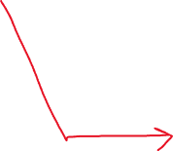

Slide 10


